Slide 1
ANOVA, Multiple comparisons & Type I Errors

Slide 2
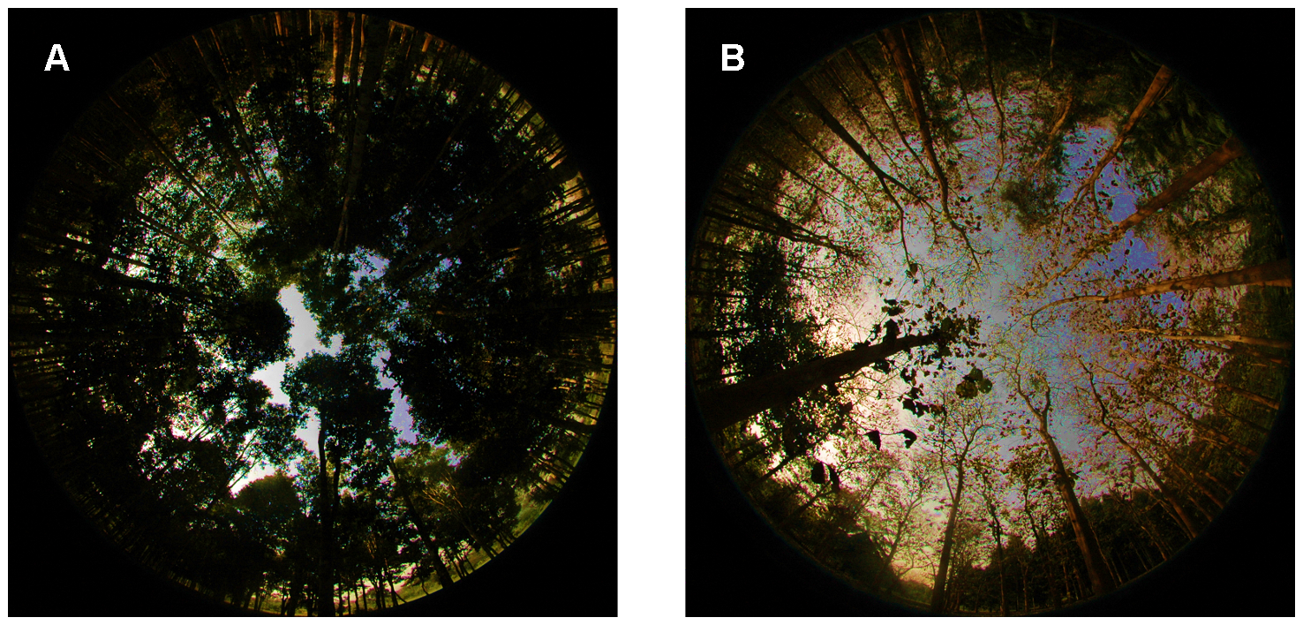

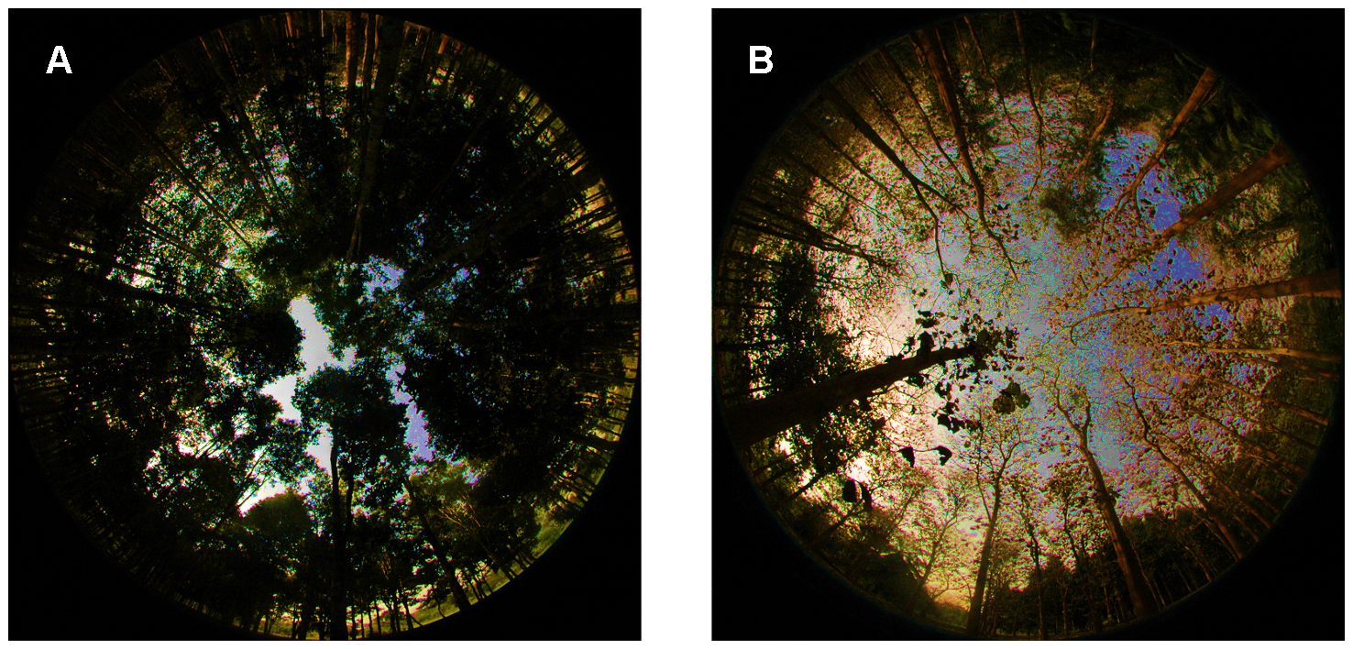
Fisheye photographs & canopy closure
(hemispheric photo)
Glathorn & Beckschäfer 2014 PLOS

Slide 3
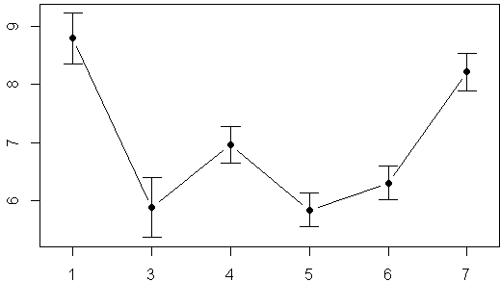
Canopy closure above 7 forest plots
More light
How open is canopy at each plot?
Less light
Error bars = 95%CI
Plot 1
Plot Number

Slide 4
Overall steps in an ANOVA
1) Plot raw data with boxplots & histograms
2) Plot mean values w/ confidence intervals
3) Do omnibus F-test to determine if there are any significant differences
4) If p < 0.05 at least 1 pair of means are different (but which pair?)
5) Do pairwise comparisons using modified t-tests as needed
6) Correct for multiple comparisons as needed

Slide 5

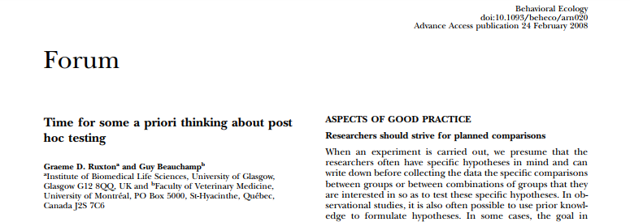

Slide 6
2 Types of pairwise comparisons
“Planned Comparisons”
“Un-planned comparisons”
These comparisons are/were:
planned before the study was conducted (eg, placebo vs. drug)
Those that determined how the study was designed
Usually much fewer in number than all possible comparisons
Often comparisons between a control (eg. Placebo) & several treatments (drug.1, drug.2, drug.3)
These are Usually used to test hypotheses the come up AFTER the data were collected and/or analyses began
Eg., both drug.2 & drug.3 decrease blood pressure. Is the effect of drug.2 > drug.3?
These can often be large in number
Often called “data dredging” or “fishing.”
Often result in after-the-fact explanations (“hand waving”)
Should best be considered as exploratory analyses that should be followed up by a new study

Slide 7
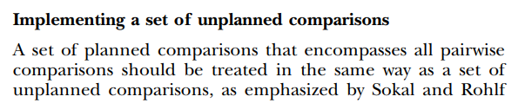
Note:
some ecologists assert that if you are doing more than 2 or 3 “planned” pairwise comparisons, you should still treat them as un-planned

Slide 8
Types of pairwise comparisons
“Planned Comparisons”
“Un-planned comparisons”
These comparisons are/were:
planned before the study was conducted (eg, placebo vs. drug)
Those that determined how the study was designed
Usually much fewer in number than all possible comparisons
Often comparisons between a control (eg. Placebo) & several treatments (drug.1, drug.2, drug.3)
These are Usually used to test hypotheses the come up AFTER the data were collected and/or analyses began
Eg., both drug.2 & drug.3 decrease blood pressure. Is the effect of drug.2 > drug.3?
These can often be large in number
Often called “data dredging” or “fishing.”
Often result in after-the-fact explanations (“hand waving”)
Should best be considered as exploratory analyses that should be followed up by a new study
New movement in Psychology & medical studies
“Pre-registration” of
studies/experiments, their design, the planned comparisons & statistical techniques
Why pre-register studies?

Slide 9
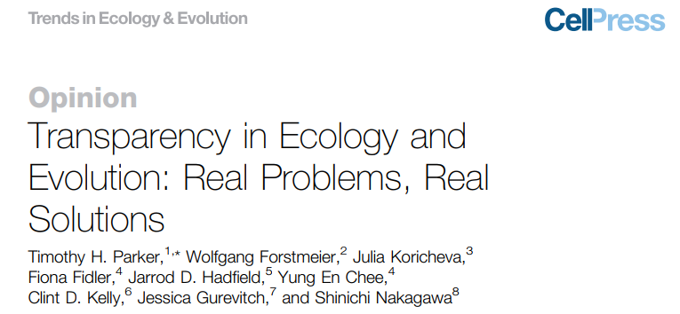
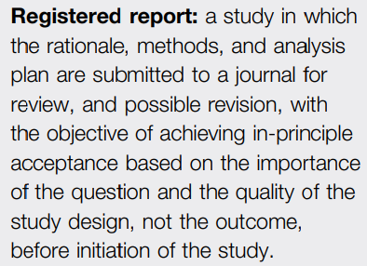
Preregistration & registered reports
in Ecology

Slide 10
Types of pairwise comparisons
“Planned Comparisons”
“Un-planned comparisons”
In practice, “un-planned” comparisons often result in apparently novel findings – yeah!
Fame & glory…
… and then the results can never be replicated by another lab.
These comparisons are/were:
planned before the study was conducted (eg, placebo vs. drug)
Those that determined how the study was designed
Usually much fewer in number than all possible comparisons
Often comparisons between a control (eg. Placebo) & several treatments (drug.1, drug.2, drug.3)
These are Usually used to test hypotheses the come up AFTER the data were collected and/or analyses began
Eg., both drug.2 & drug.3 decrease blood pressure. Is the effect of drug.2 > drug.3?
These can often be large in number
Often called “data dredging” or “fishing.”
Often result in after-the-fact explanations (“hand waving”)
Should best be considered as exploratory analyses that should be followed up by a new study

Slide 11


Slide 12
Types of pairwise comparisons
“Planned Comparisons”
“Un-planned comparisons”
In practice, “un-planned” comparisons often result in apparently novel findings – yeah!
Fame & glory…
… and then the results can never be replicated by another lab.
Why does the replication fail?
These comparisons are/were:
planned before the study was conducted (eg, placebo vs. drug)
Those that determined how the study was designed
Usually much fewer in number than all possible comparisons
Often comparisons between a control (eg. Placebo) & several treatments (drug.1, drug.2, drug.3)
These are Usually used to test hypotheses the come up AFTER the data were collected and/or analyses began
Eg., both drug.2 & drug.3 decrease blood pressure. Is the effect of drug.2 > drug.3?
These can often be large in number
Often called “data dredging” or “fishing.”
Often result in after-the-fact explanations (“hand waving”)
Should best be considered as exploratory analyses that should be followed up by a new study

Slide 13
Types of pairwise comparisons
“Planned Comparisons”
Conducting many comparisons increases the Probability of a Type I error
Rejecting the null hypothesis when it actually shouldn’t be rejected
“Rejecting a true null hypothesis”
“False positive"
In practice, “un-planned” comparisons often result in apparently novel findings – yeah!
Fame & glory…
… and then the results can never be replicated by another lab.
Why does the replication fail?
These comparisons are/were:
planned before the study was conducted (eg, placebo vs. drug)
Those that determined how the study was designed
Usually much fewer in number than all possible comparisons
Often comparisons between a control (eg. Placebo) & several treatments (drug.1, drug.2, drug.3)

Slide 14
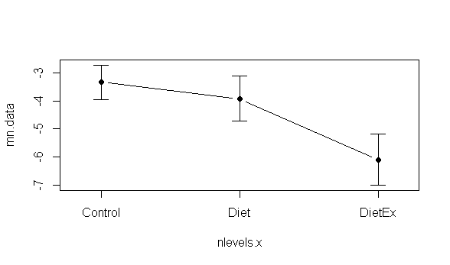
Effects of different diets on weight loss
Weight loss
(lbs)
Diet.1
Diet.2
Treatment

Slide 15
Effects of different diets on weight loss:
Planned Comparisons
Weight loss
(lbs)
Control vs Diet 1
Control vs. Diet 2
Diet.1
Diet.2
Treatment

Slide 16
Effects of different diets on weight loss:
UN-Planned Comparisons
Weight loss
(lbs)
Diet 1vs Diet 2
Diet.1
Diet.2
Treatment

Slide 17
Planned Comparisons:
-Most ecologists won’t “correct” for this…but there is some debate…
-use t-test or “modified t-test” to compare pairs of means->modified t-test more powerful
-requires honesty about what comparisons were planned
-journal editors may require that you do re-do analysis & do corrections
Weight loss
(lbs)
Control vs Diet 1
Control vs. Diet 2
Diet.1
Diet.2
Treatment

Slide 18
UN-Planned Comparisons:
-Require that p-values be “corrected” so that Type-1 errors do not get “inflated”
-Many many many many many ways to do this
-This course/this book: Tukey Kramer / TukeyHSD method
Weight loss
(lbs)
Diet 1 vs. Diet 2
Diet.1
Diet.2

Slide 19
Type 1 Error:
Accidently rejecting a TRUE null hypothesis
(thinking Ha is true even though it isn’t; “false positive”)
Say we get data like this:
Weight loss
(lbs)
Diet 1 vs. Diet 2
Diet.1
Diet.2

Slide 20
Type 1 Error (page 160)
“Type 1 error is rejecting a true null hypothesis. The significance level alpha (α) [the threshold where we say something is “statistically significance”] sets the probability of committing a Type 1 Error.
“if the null hypothesis were true, we would reject it mistakenly one time in 20” (pg 160)
This is sometimes called a “false positive.” We falsely conclude that there is a difference when there isn’t.

Slide 21
Type 2 Error (page 160)
“Type 2 error is failing to reject a false null hypothesis”
“If a null hypothesis is false, we need to reject it to get the right answer. Failure to reject a false null hypothesis is a Type 2 error.”
This is sometimes called a “false negative.” We falsely conclude that there is not a difference when there actually is.
“A study that has a low probability of Type 2 error is said to have high power.”

